Slide 1

Path to Sustainable Growth Data-Driven Insights :
Optimizing Operations for Increased Revenue and Customer Satisfaction

Slide 2
Purpose :
Key Areas of Focus :
Financial Performance
Customer Behavior
Logistics And Fulfillment
Product Management
Customer Satisfaction And Returns
To present a comprehensive analysis of current operations, identify key insights, and propose data-driven strategies for sustainable growth.
Expected Outcome:
Improved decision-making
Increased revenue
Enhanced customer satisfaction

Slide 3


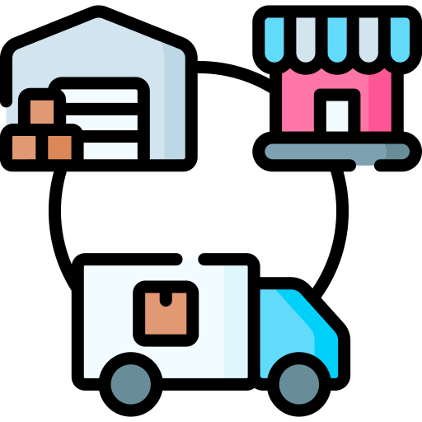

Key Challenges Faced :
Operational Inefficiencies Affecting Growth
High Return And Cancellation Rates Impacting Customer Experience
Suboptimal Logistics And Fulfillment Processes
Limited Understanding Of Customer Behavior And Preferences

Slide 4
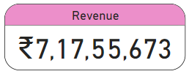
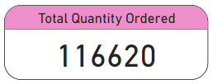
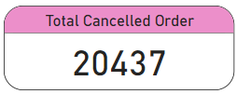
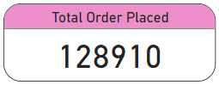
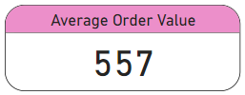
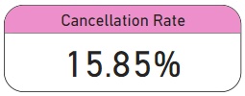
Major KPIs

Slide 5
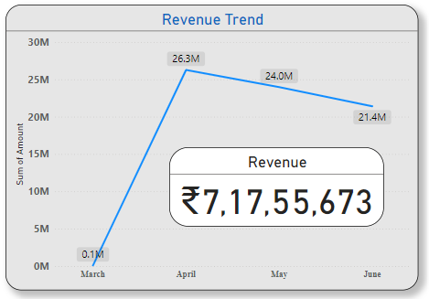
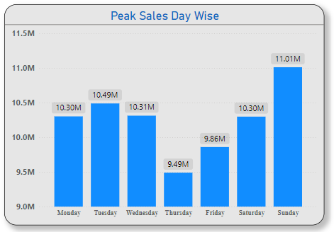
Financial Performance Analysis
Revenue Trend
Day-Wise Sales

Slide 6
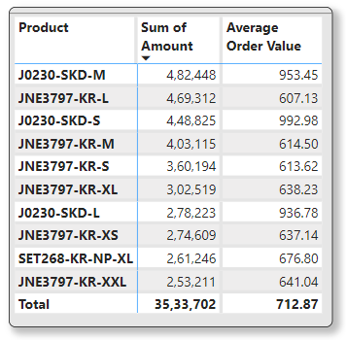
Financial Performance Analysis
Top 10 Selling Products & their Average Order Value

Slide 7



Key Findings : (Financial Performance Analysis)
Revenue is decreasing from past three months
Sunday having the highest sales day contributing in 15.34% of total sales
The top 10 products sharing around 5% of total revenue

Slide 8
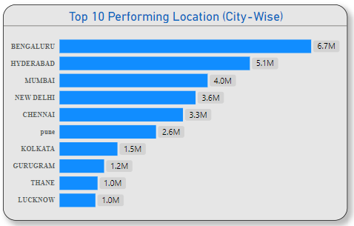
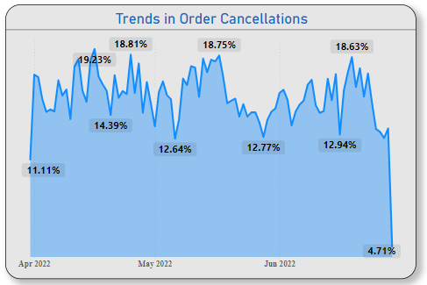
Customer Insights
Top Performing Locations
Trend in Order Cancellations

Slide 9
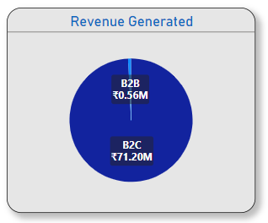
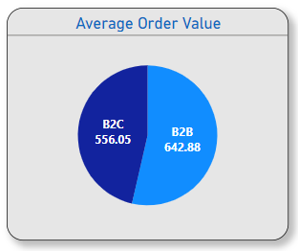
Customer Insights
Average
Order
Value
Revenue
Generated
B2B Vs B2C

Slide 10



Key Findings : (Customer Insights)
Bangalore,Hyderabad,Mumbai Top 3 locations sharing 22% of total revenue.
Cancellation rate Ranging between 11%-19% can be the revenue loser.
B2C vs B2B Major revenue coming from B2C. Focus needed on B2B.

Slide 11
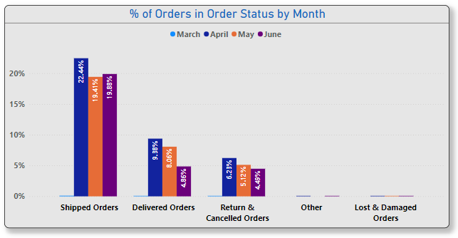
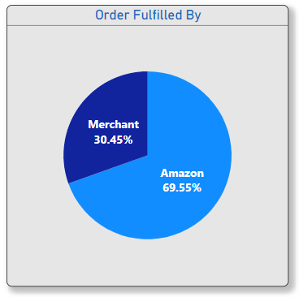
Logistics & Fulfilments
Month wise, % of Orders by Order Status
Orders Fulfilled By

Slide 12


Key Findings : (Logistics & Fulfillments)
Only 5-10% order getting delivered is the challenge in logistics and delaying the orders
18-22% orders are in shipping every month is catching eyes for imperfect delivery process
70% orders are fulfilled by Amazon.

Slide 13
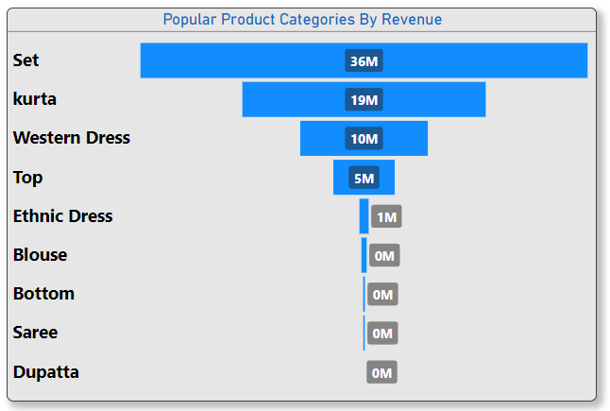
Product Management
Popular Product Categories
By Revenue

Slide 14
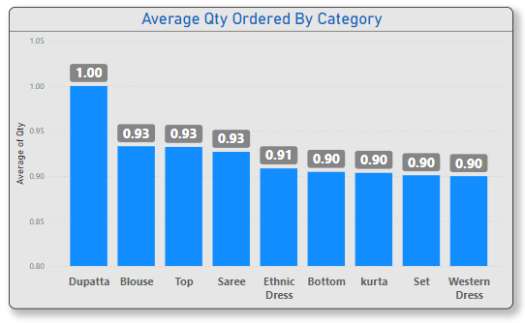
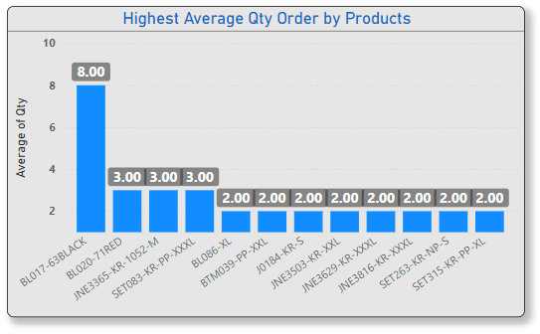
Product Management
Average Qty By Category
Products with Highest Average Qty

Slide 15



Key Findings : (Product Management)
“Set” category is sharing 50% of the total revenue.
“dupatta” category is having Highest Average Quantity ordered.
“BL017-63BLACK” is popular product having highest average order quantity of 8.

Slide 16
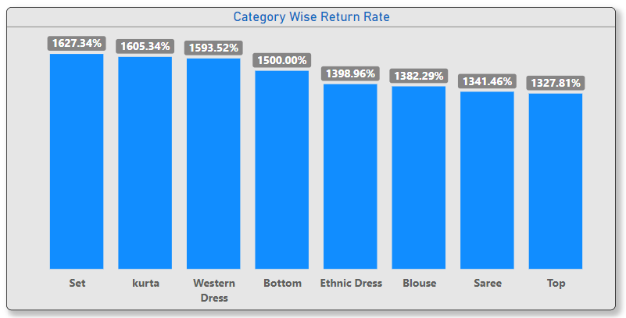
Customer Satisfaction & Returns
Return Rate
By
Category

Slide 17
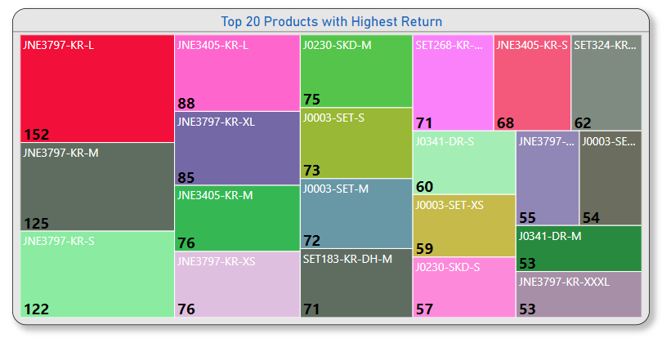
Customer Satisfaction & Returns
Problematic Products :
Top 20 products with highest return orders.

Slide 18


Key Findings : (Customer Satisfaction & Returns)
“Set” category is having highest return rate.
Some products are having 10,000% return rate that should be removed from inventory

Slide 19
Action Plans
Short Term Plan
Mid Term Plan
Long Term Plan
Reduce returns by removing high-return products and improving quality.
Boost inventory for top-selling products.
Launch targeted marketing in high-revenue cities and reduce cancellations.
Optimize logistics by reducing shipping delays and relying less on Amazon.
Refine product portfolio and introduce popular bundles.
Tailor marketing for B2B and B2C segments.
Invest in advanced analytics and automated inventory management.
Adopt sustainable practices and scale operations.
Develop a loyalty program to enhance retention and increase order value.

Slide 20
Recommendations for Sustainable Growth
Inventory Optimization Stock more of popular product categories based on sales data.
Targeted Marketing Develop separate strategies for b2b and b2c segments based on purchasing behavior.
Logistics Improvement Focus on optimizing fulfillment methods and reducing shipping times for better efficiency.
Customer Experience Enhancements Address quality issues with high-return products to improve satisfaction.

Slide 21
Conclusion
Financial Performance: Revenue has declined in recent months, with Sundays seeing peak sales. Top products drive a small but significant portion of revenue. Focus on improving sales during off-peak days and expanding top-seller availability.
Customer Insights: Bangalore, Hyderabad, and Mumbai are top revenue drivers. B2C dominates, but B2B shows growth potential. Focus on regional targeting and personalized marketing.
Logistics & Fulfillment: Shipping delays and heavy reliance on Amazon fulfillment are key challenges. Optimizing internal fulfillment processes is essential for better control.
Product Management: "Set" category performs well; "Dupatta" sees high order quantities. Improve bundling and inventory management for growth.
Customer Satisfaction & Returns: Address high return rates in the "Set" category and other products. Improving quality control and returns management will enhance customer satisfaction.

Slide 22
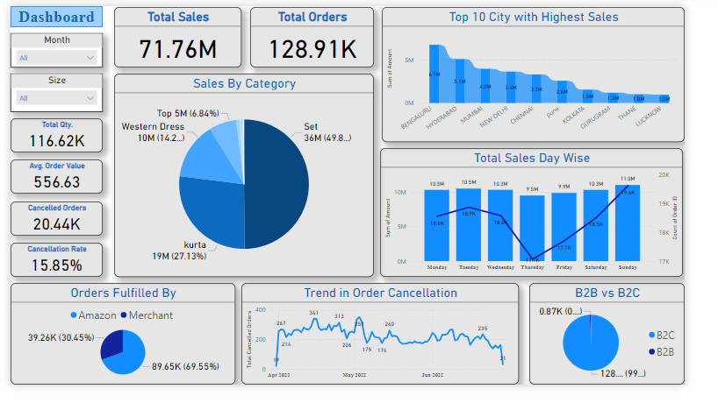
Final Dashboard View
Drill-Through By Selecting Category

Slide 23
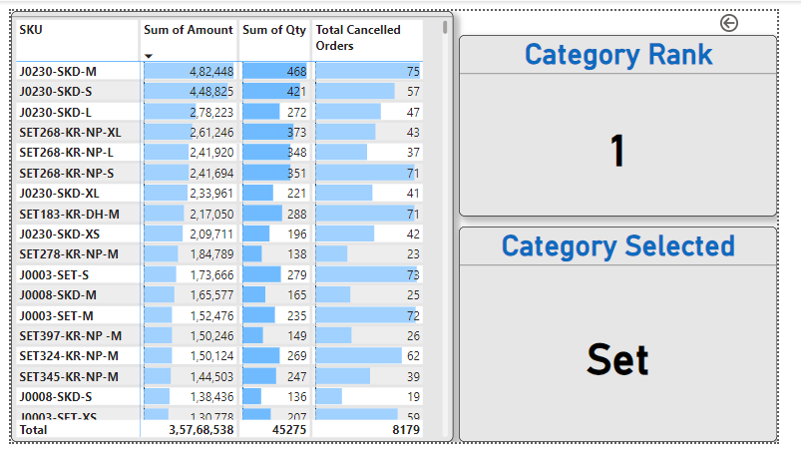
Final Dashboard View

Slide 24


Q&A
https://www.linkedin.com/in/rk-analyst/

Slide 25

Thank You
Presented By

